Slide 1
JOURNEY PPT
Foundation Training
04 Sept – 08 Sept
- Musaddiq Shariff

Slide 2
Week 3 : Day 1 – Azure Storage
Understanding Azure storage types
Understanding Azure Redundancy options
Azure Blob storage
Creating Azure Data lake Gen 2
Compare Data Lake Storage Gen2 and Azure Blob Storage

Slide 3
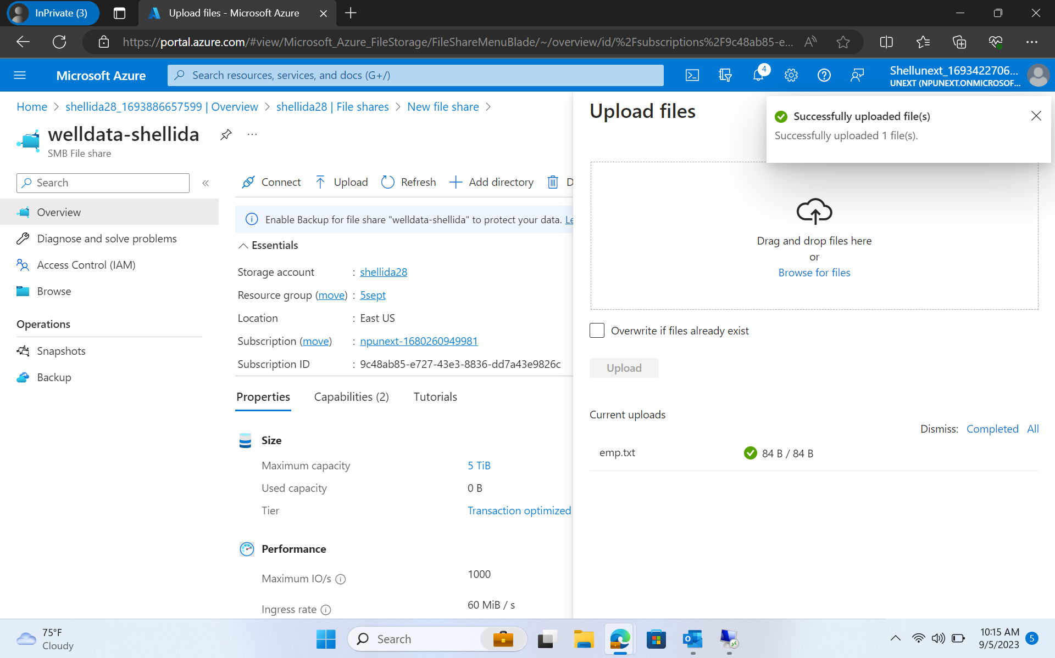
Blob Storage

Slide 4
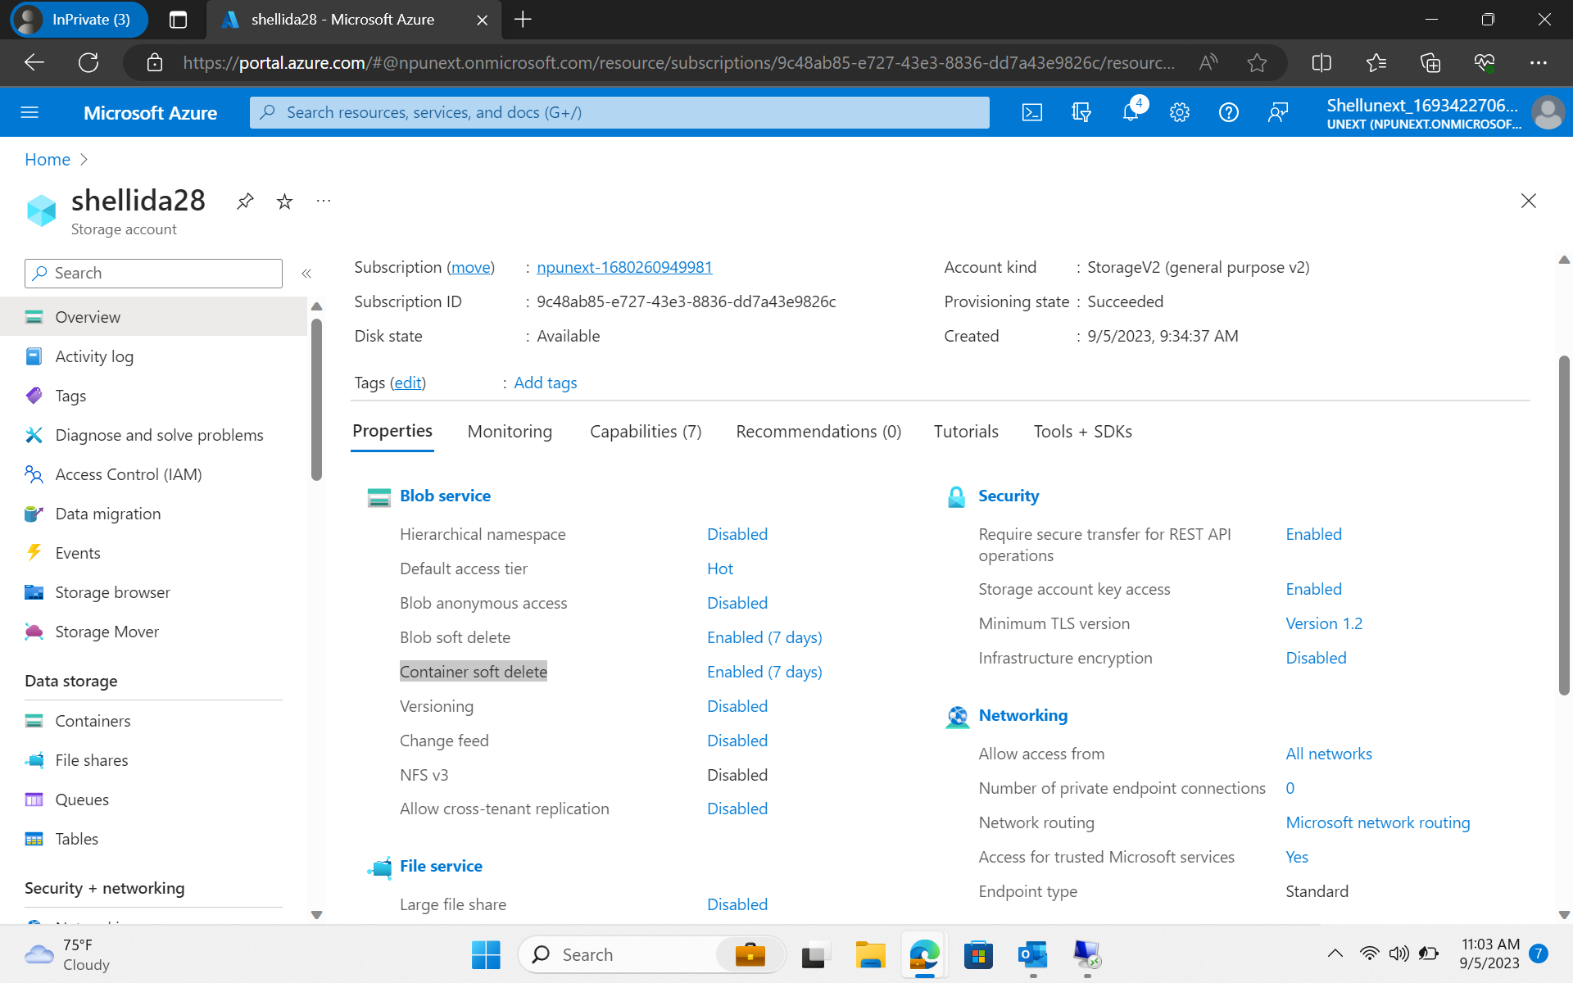
Blob Storage

Slide 5
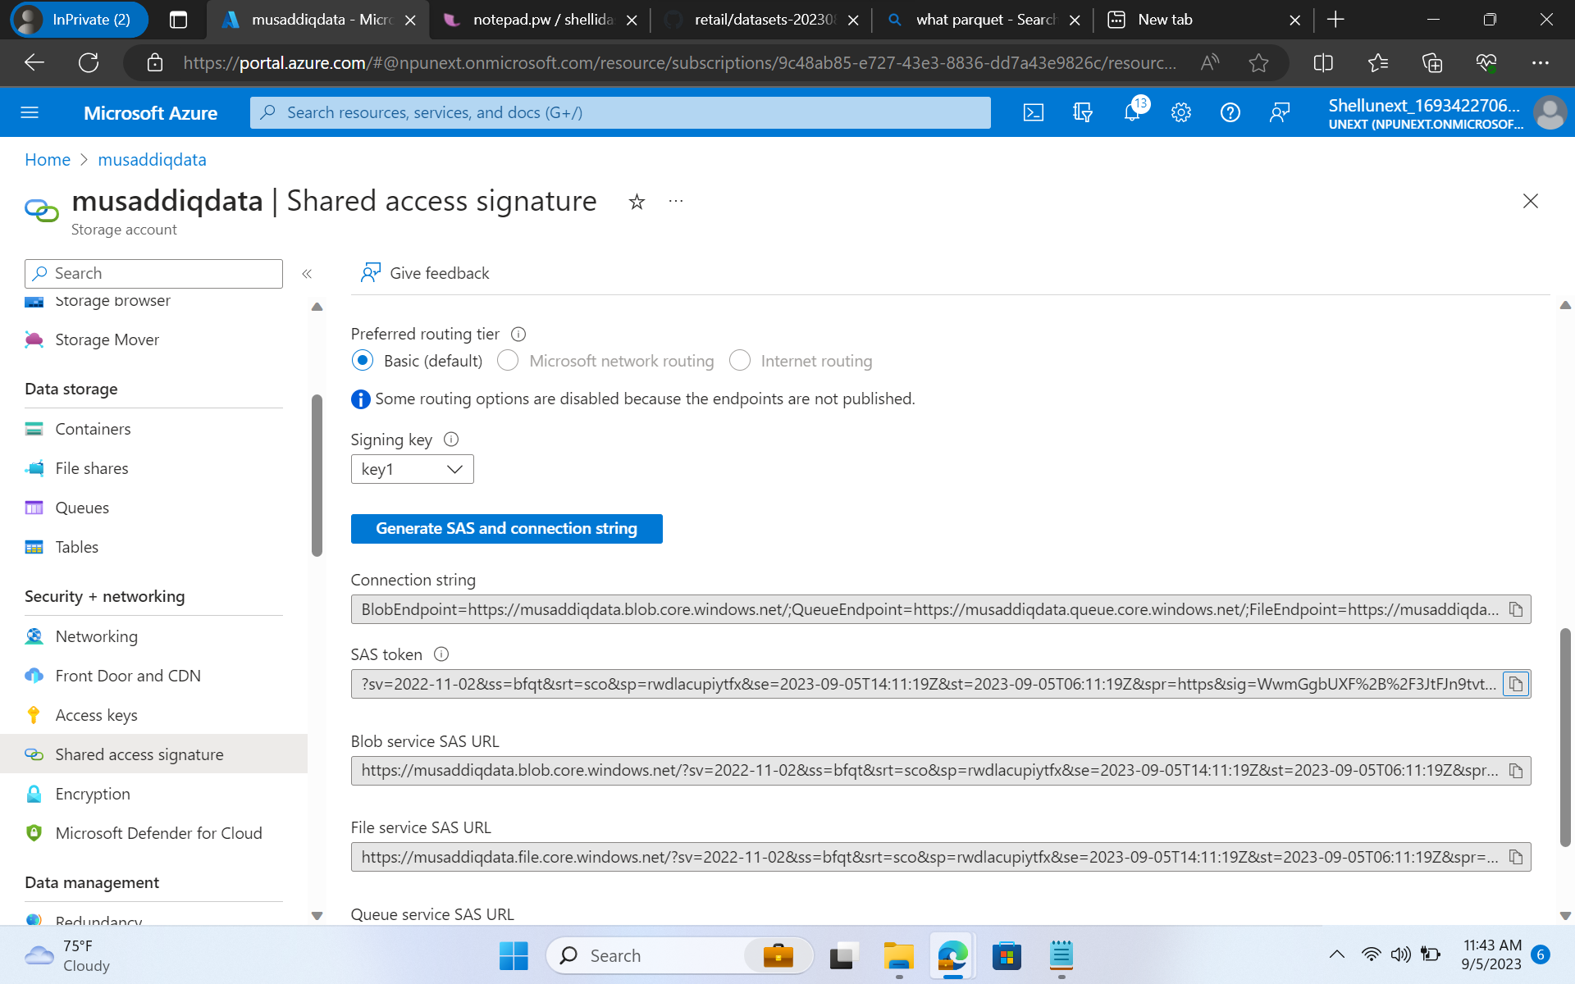
SAS

Slide 6
Day 2 - Azure Storage cont..
Access and authentication
Secure Access to Azure Storage
upload data into data lake gen2
Azure Data Factory introduction
ELT vs ETL
Dataset , Integration run time
parameters, system variables

Slide 7
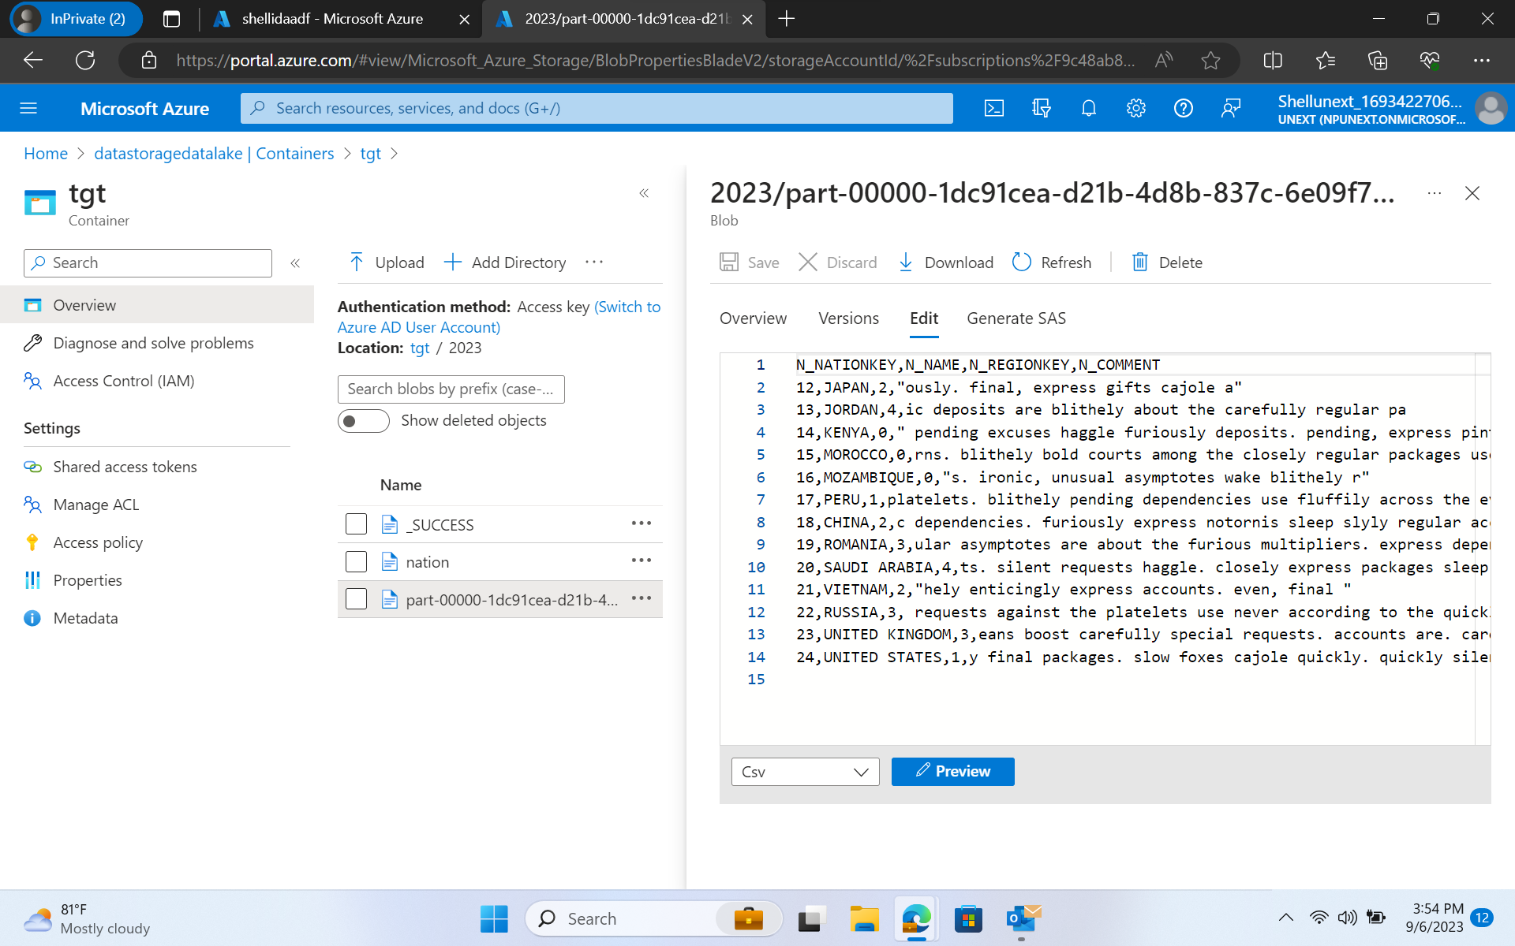
Azure Data Lake Storage

Slide 8
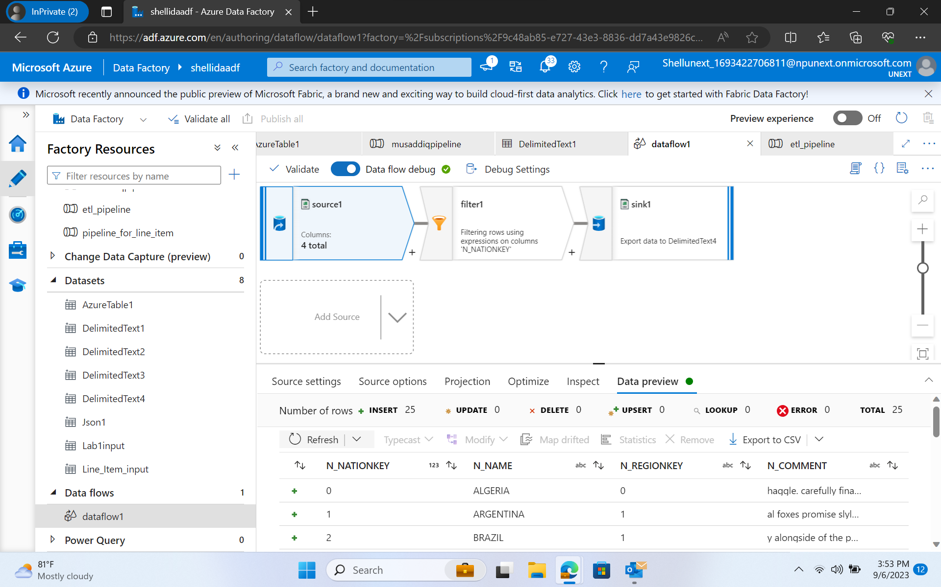
ADF

Slide 9
Day 3 – ADF cont..
ADF components
Copy Data Flow activity in ADF
Linked services, Input & Output Data Set in ADF
Control Flow Activity
Get Metadata Activity
Filter and If Activity
Wait and foreach loop activity

Slide 10
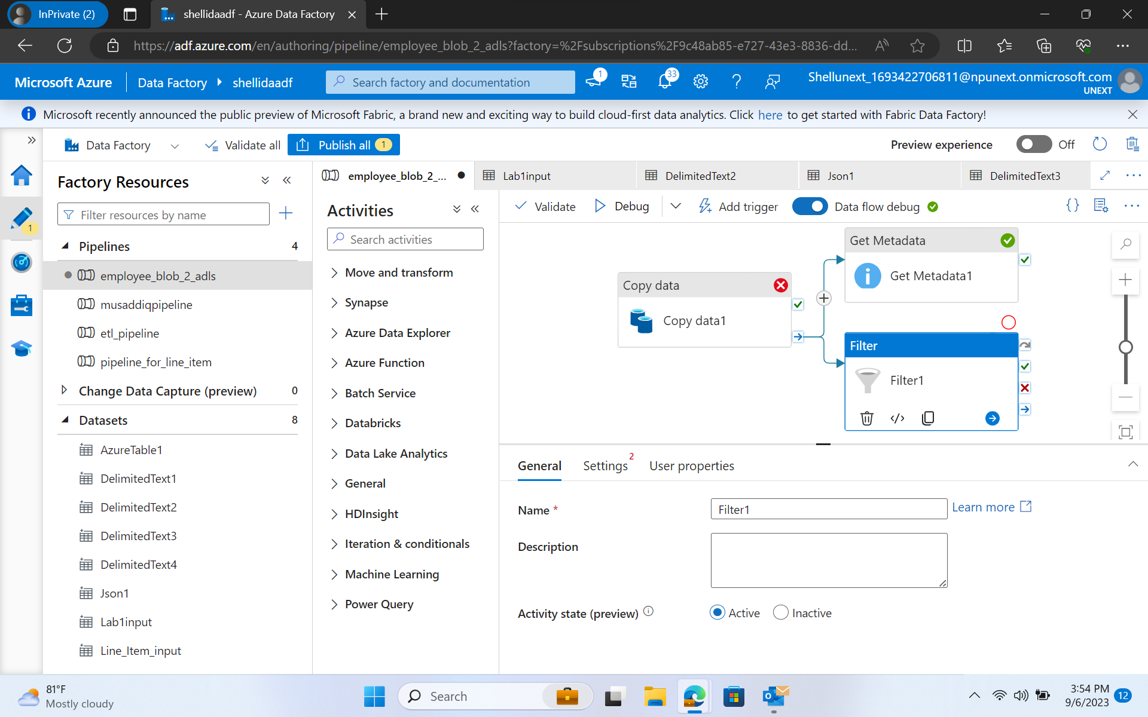
ADF

Slide 11
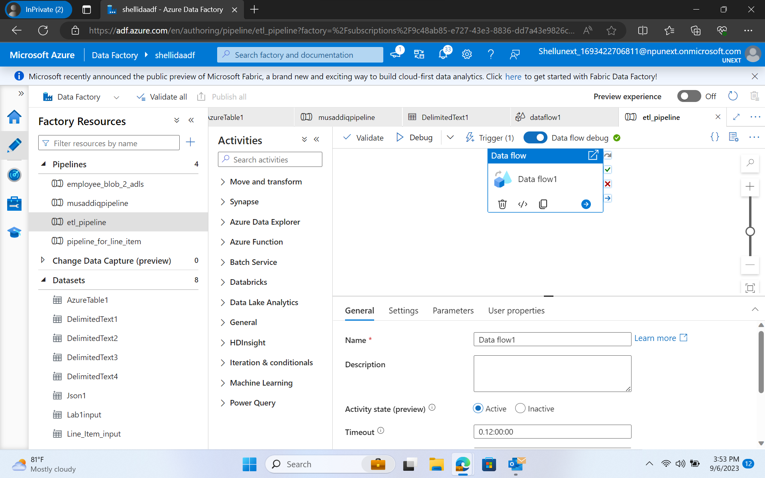
ADF

Slide 12
Day 4 – ADF cont..
Mapping Dataflow Transformation ,source transformation, sink transformation, surrogate key transformation
Conditional split transformation, Derived column transformation
API- based Integration : Understanding
Exploring the API – based Integration
Introduction to CDC
Understanding CDC in context of database and system
Use cases for CDC and its benefits in integration scenarios.

Slide 13
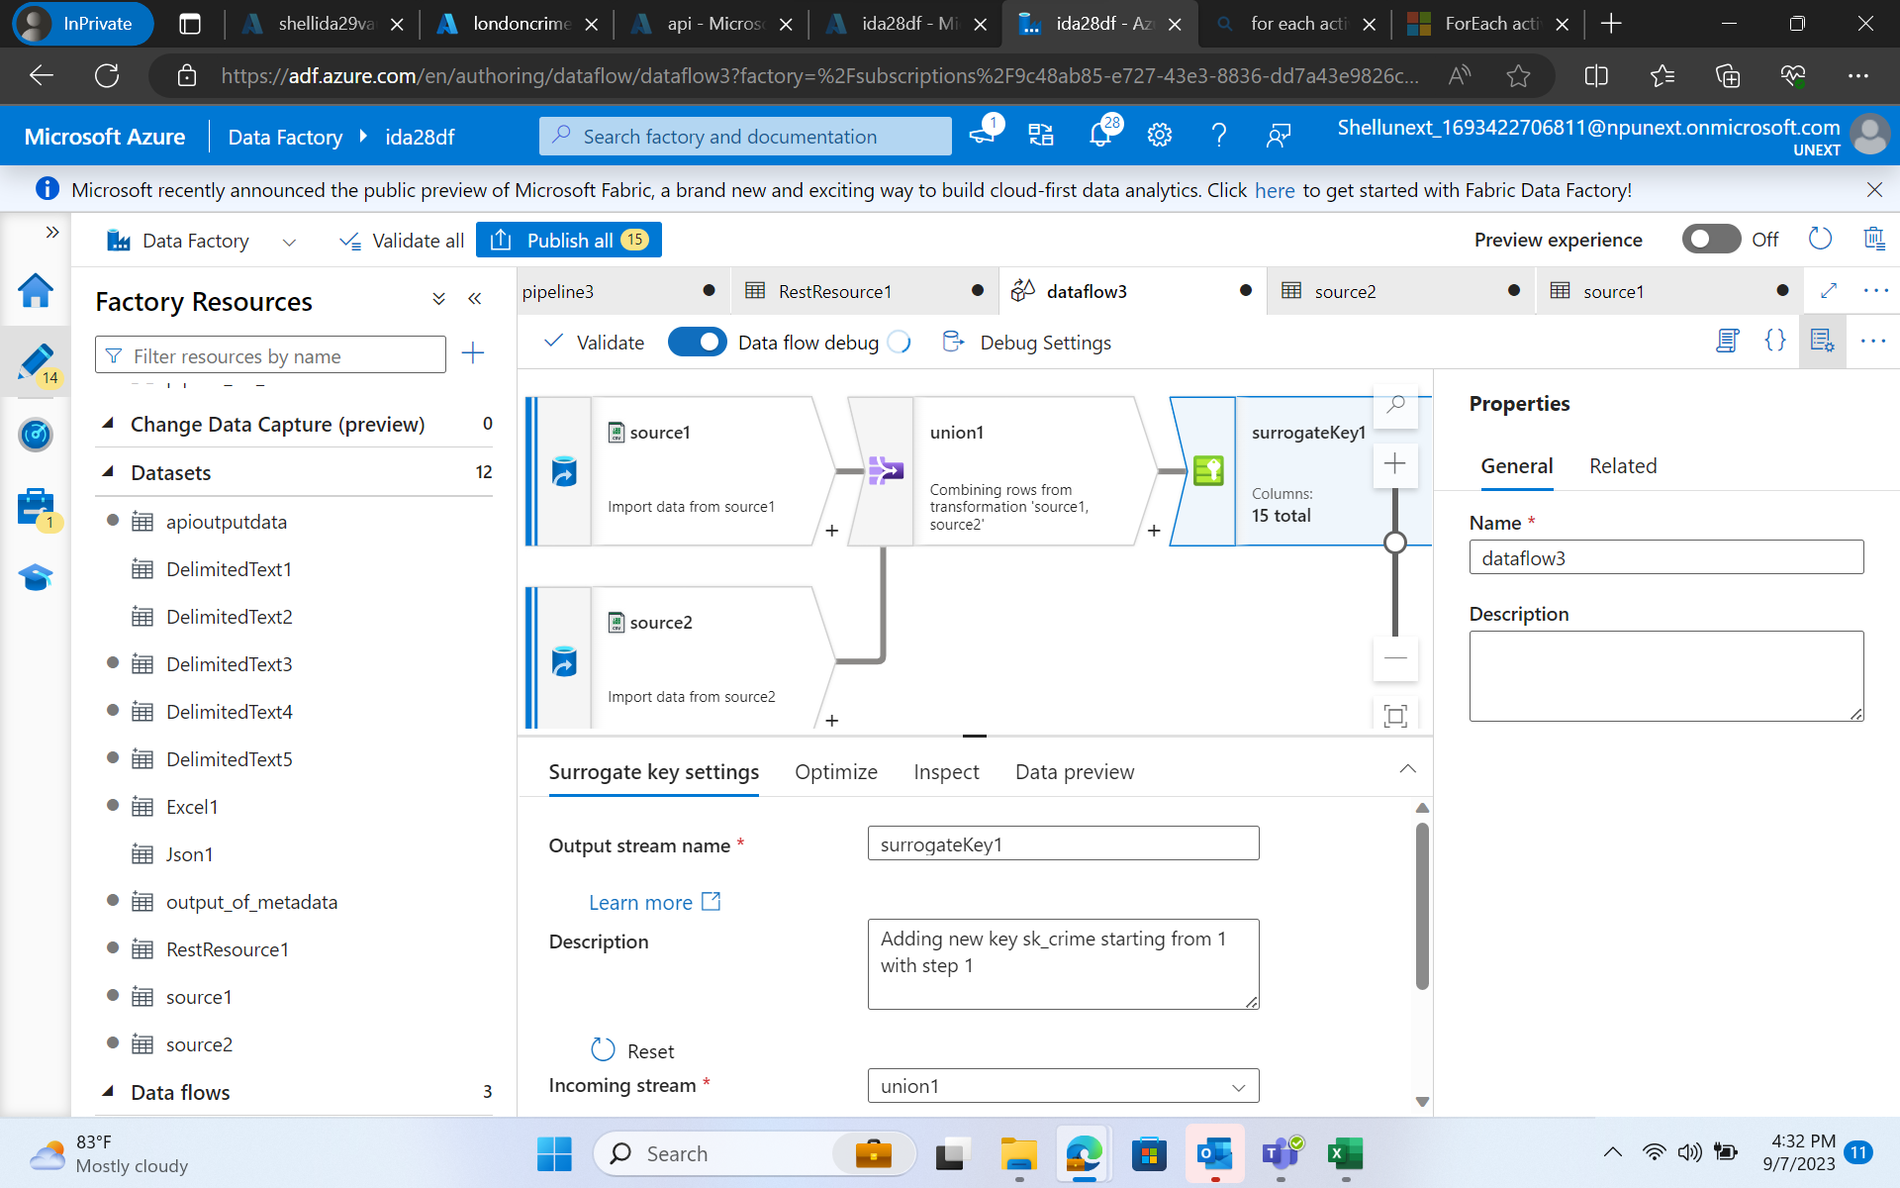
ADF

Slide 14
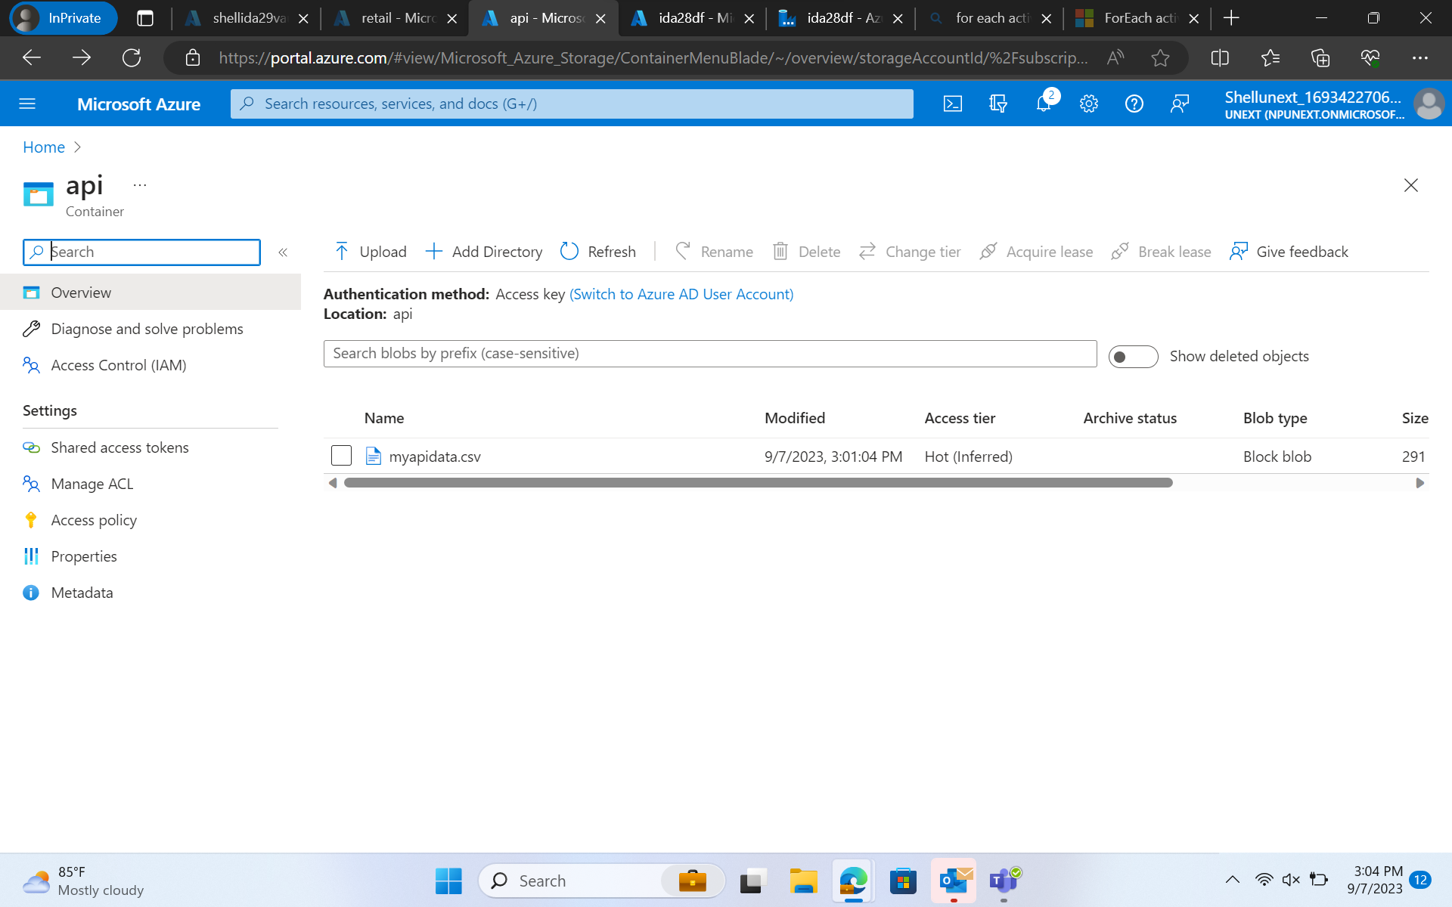
ADF

Slide 15
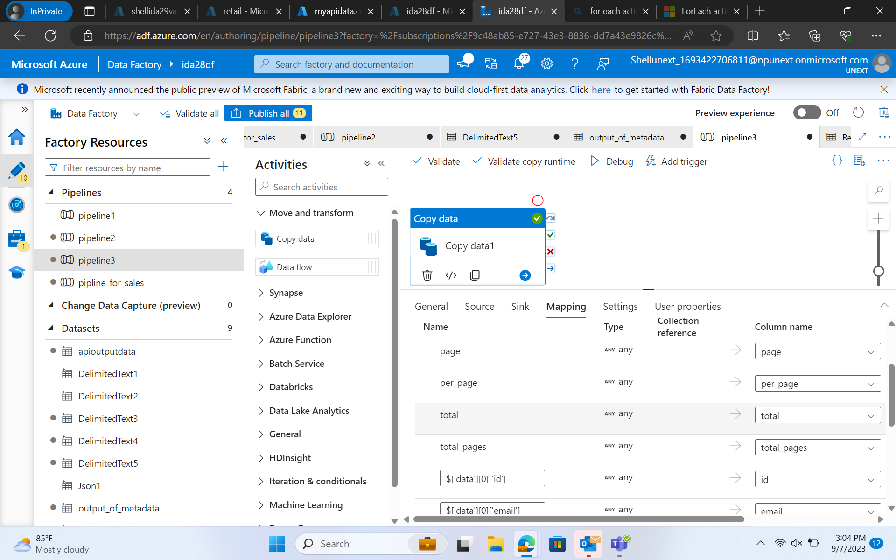
ADF

Slide 16
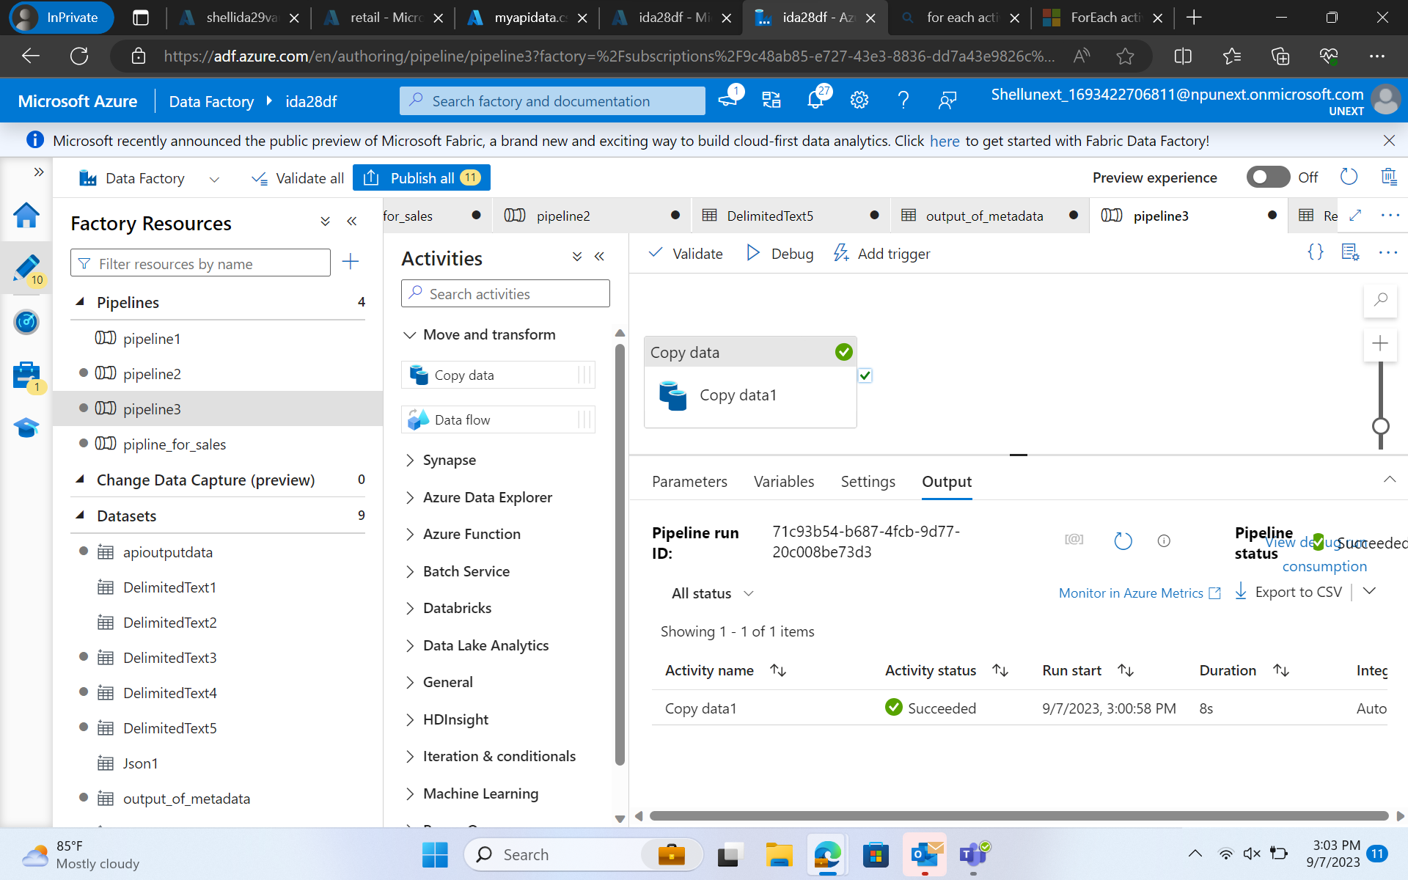
ADF

Slide 17
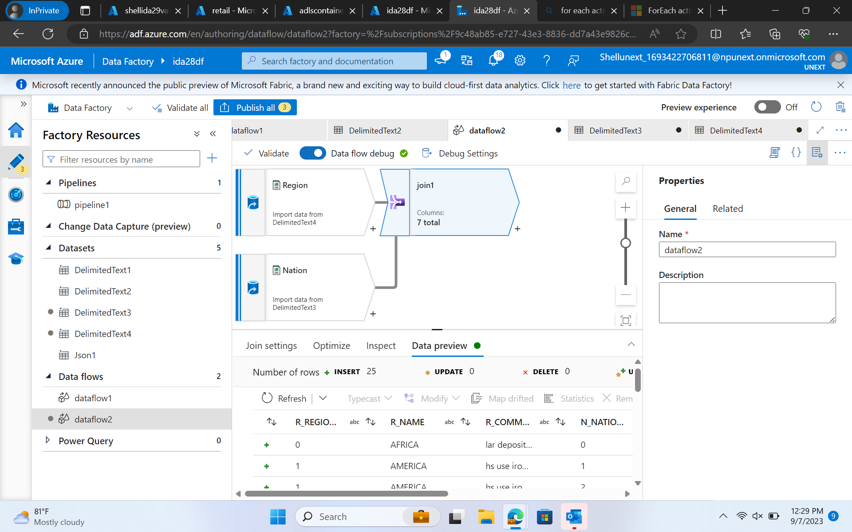
ADF

Slide 18
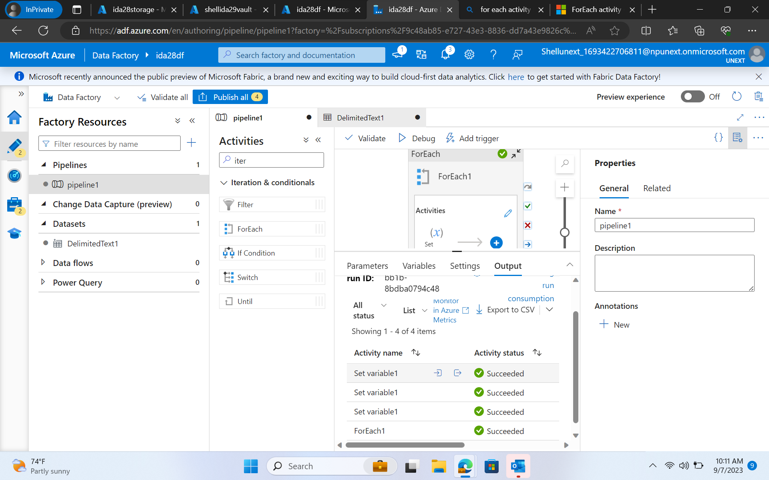
ADF

Slide 19
Day 5 – Azure SQL Database
Hands-on on sql database creation
loading the tables into the storage account
Creation of pipeline for sql database
Fetching, updating rows of a table and getting affected in adf and datastorage
Creating the dataflow and cdc for the instances
Debugging and triggering the dataflow and cdc

Slide 20
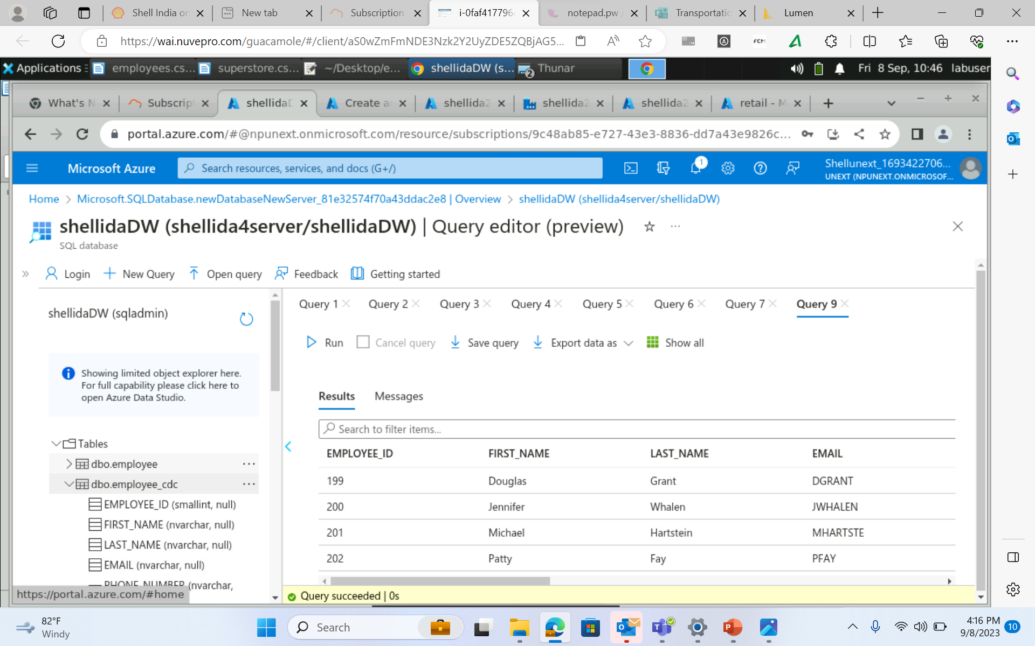
ADF

Slide 21
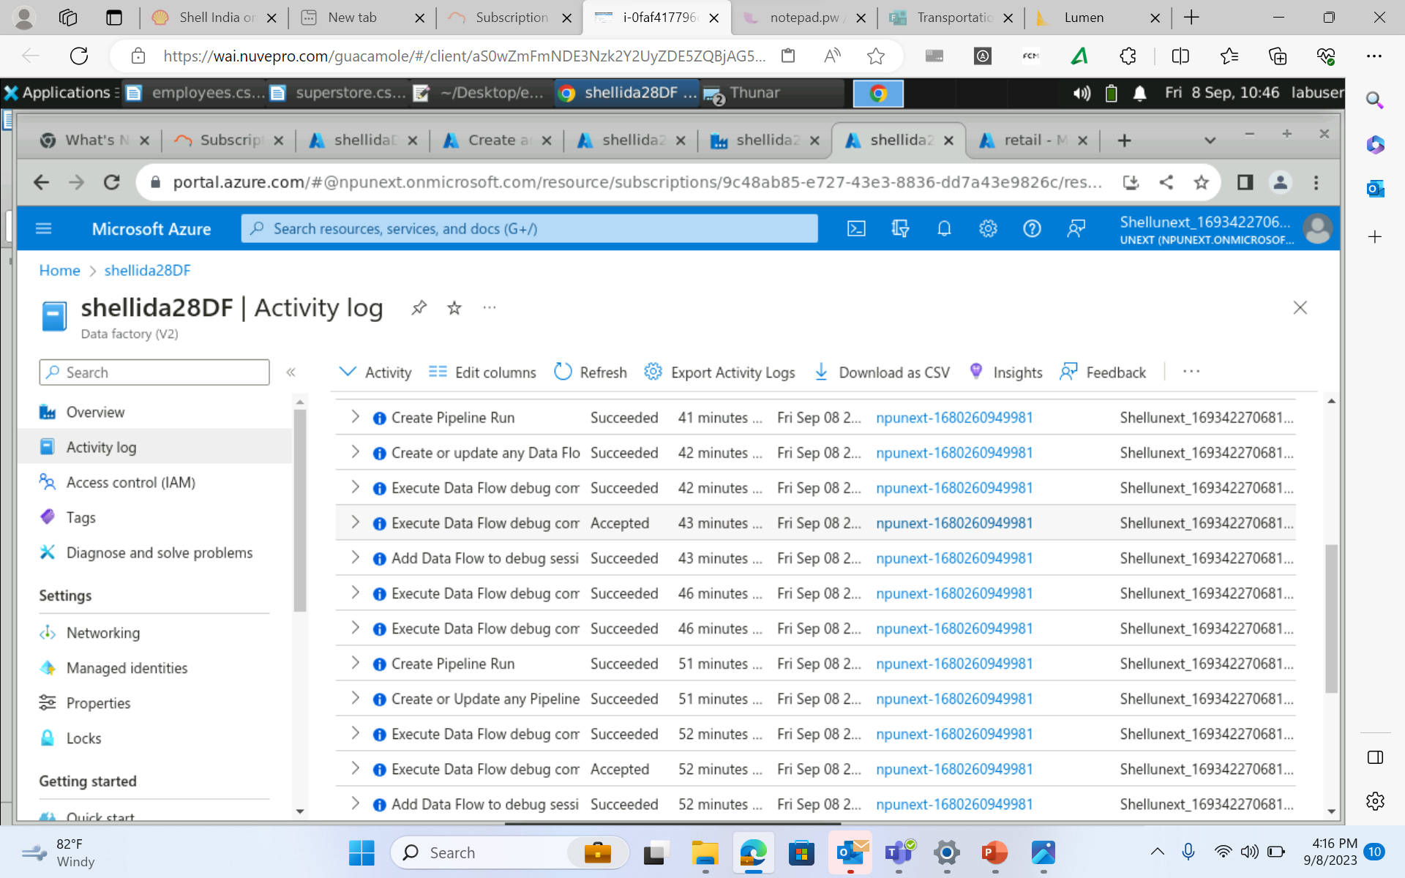
ADF

Slide 22
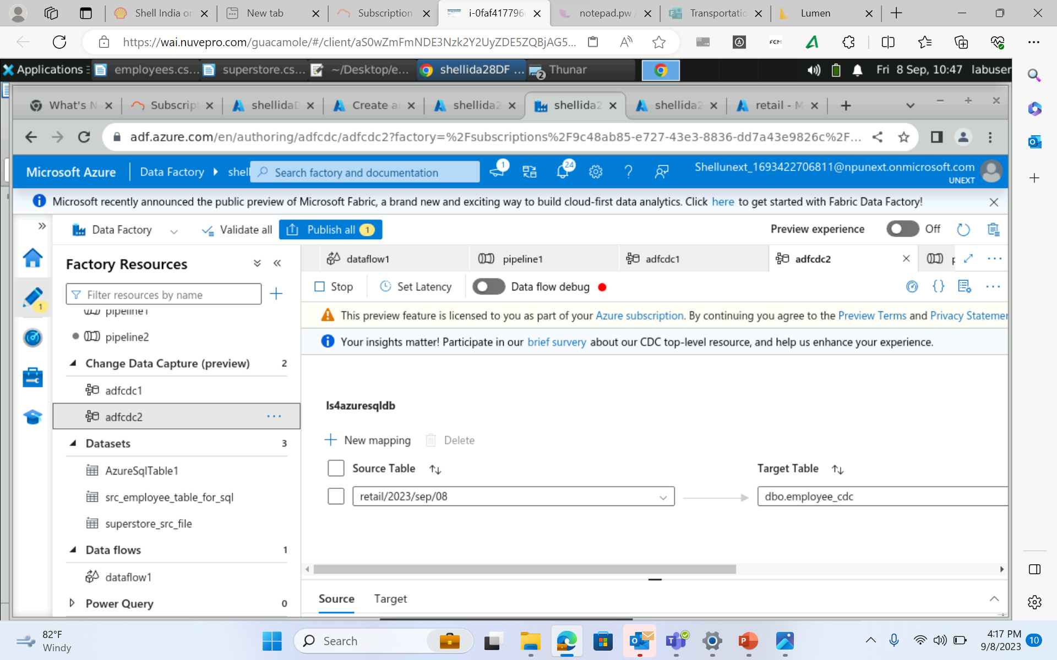
ADF

Slide 23
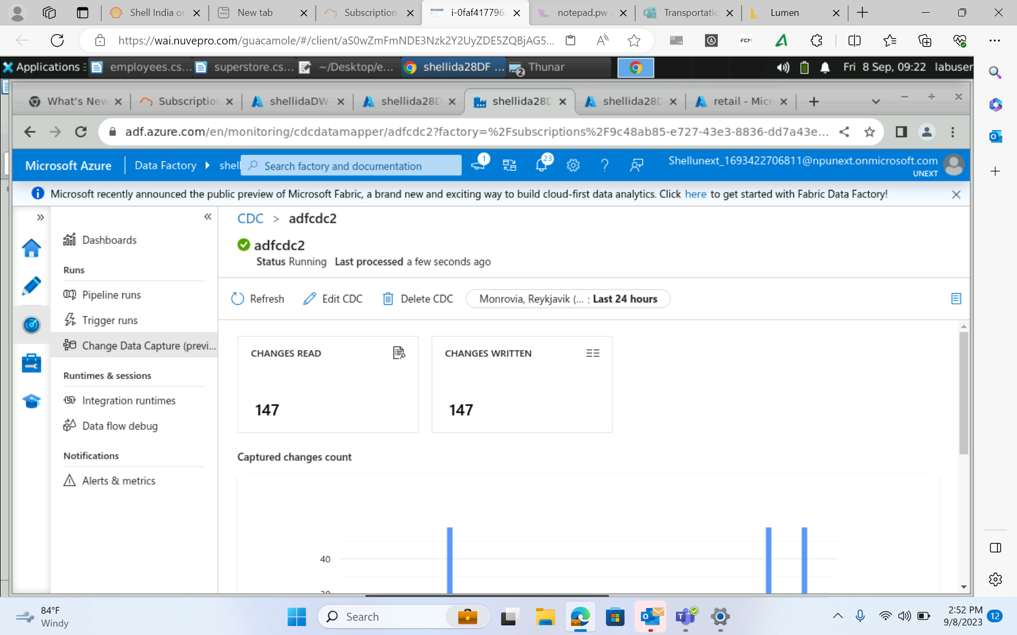
ADF

Slide 24
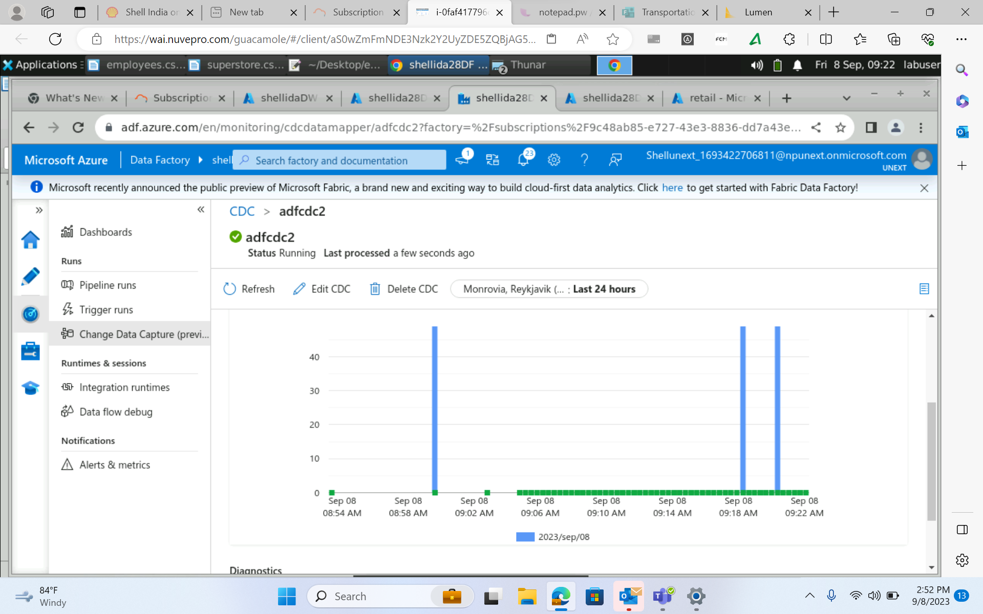
ADF

